Slide 1

Donut Give Up!
Crissy Neff
David Sant
Patrice Secrist
Mazen Salama
April 23, 2019

Slide 2
Quality Measure
HbA1c: Percent of glycosylated hemoglobin
Outcome Measure
Also a management measurement
Used to diagnose diabetes
American Diabetes Association (ADA) original source
Prediabetic: HbA1c 5.7–6.4%
Diabetic :HbA1c > 6.5%
Diabetic management goal HbA1c <7%
Adopted by World Health Organization(WHO)
HbA1c > 6.5% is considered diabetic
Notes:
The World Health Organization
An HbA1c of 6.5% is recommended as the cut point for diagnosing diabetes. A value less than 6.5% does not exclude diabetes diagnosed using glucose tests. The expert group concluded that there is currently insufficient evidence to make any formal recommendation on the interpretation of HbA1c levels below 6.5%
American Diabetes Association
Patients with prediabetes are defined by the presence of IFG and/or IGT and/or A1C 5.7–6.4% (39–47 mmol/mol)
Patients with two HbA1c tests 6.5% or above are diabetic. 90-95% of these cases are type 2 diabetes.
A reasonable A1C goal for many nonpregnant adults is <7% (specifically referring to type 2

Slide 3
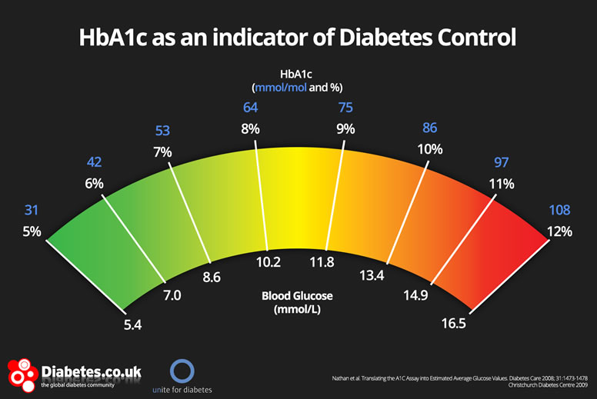
Why HbA1c?
Diagnosis
HbA1c is the most simple and common to diagnose diabetes.
Other tests include:
Fasting Plasma Glucose (FPG)
Requires Fasting
Oral Glucose Test (OGT)
Requires taking 75g of glucose at one time
Random plasma glucose test
Not as sensitive as HbA1c
Diabetes Management
Good Management: HbA1c < 7%
Fair Management: HbA1c >7% < 9.3%
Poor Management: HbA1c > 9.3%
ADA recommends diabetic individuals test HbA1c:
Semi-annually if meeting treatment goals and stable glycemic control
Quarterly if patient’s therapy changed or aren’t meeting goals
Notes:
HbA1c is not the only way to diagnose diabetes, but is the most common.
Other tests include
Fasting Plasma Glucose (FPG)
Normal is less than 100 mg/dl
Prediabetes is 100 to 125 mg/dl
Diabetes is 126 mg/dl or higher
Oral Glucose Test
Normal is less than 140 mg/dl
Prediabetes is 140 to 199 mg/dl
Diabetes is 200 mg/dl or higher
Random plasma glucose tests above 200 mg/dl are also indicative of diabetes
HbA1c does not require fasting or taking 75g of glucose at one time, and is more sensitive than a random plasma glucose test.
HbA1c is also important because it is used after diagnosis of diabetes to determine how well patients are managing their hyperglycemia.
Recommendations for HbA1c testing from the American Diabetes Association for individuals with diabetes (any type):
HbA1c is also important because it is used after diagnosis of diabetes to determine how well patients are managing their hyperglycemia.
Recommendations for HbA1c testing from the American Diabetes Association for individuals with diabetes (any type):
At least two times per year if meeting treatment goals and stable glycemic control
Quarterly in patients whose therapy has changed or who are not meeting goals
Results < 7% are considered good management of hyperglycemia. Results between 7% and 9.3% are considered fair management of hyperglycemia. Results above 9.3% are considered poor management of hyperglycemia.

Slide 4

Current State of the Measure
The rate of good glycemic control in diabetics is increasing:
Mean HbA1c levels for diabetics are declining:
7.82% in 1999–2000
7.47% in 2001–2002
7.18% in 2003–2004
Predictive margin for having HbA1c <7.0% increased (Hoerger 2008)
37.0% in 1999–2000 to
49.7% in 2001–2002 and to
55.7% in 2003–2004.
Hb1Ac measure is accepted and used worldwide
New paper presented at ENDO 2019 Chang Villacreses et al. challenges effectiveness of diagnostic test.
A1c test misses many cases of diabetes [press release]. Washington, DC: Endocrine Society; March 23, 2019. Accessed March 23, 2019.

Slide 5

Interventions to Improve HbA1c Levels
Interventions:
Physicians education at time of diagnosis
Diet
Exercise
Alcohol
Tobacco
Medications
Blood sugar control
Referred to dietician for Medical Nutrition Therapy (MNT)
MNT associated with 0.3%-2% HbA1c decrease.
Recently capillary 2-FP analyzer has been found suitable for measurement
Inconvenient, expensive for smaller health facilities to test Hb1Ac
New method:
Patients place a blood sample on filter paper and mail it to a lab.
Found to be reliable and can be done at home or in a clinic.

Slide 6
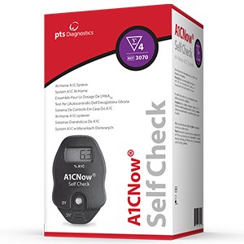
Emeasures
Home digital A1c kits are available at drugstores.
~$50 and come with 4 test strips.
Test strips are not available separately from the device
Device is thrown away after 4 uses.
They require some manual dexterity to use and some counter space, but the accuracy is fairly good.
This analyzer does not connect to a digital application
Many apps can track blood sugar and HbA1c
Could be used in tandem with the home device.
Similar devices marketed to physicians connect to Bluetooth (prices not published)
Because other countries use a different unit of measure for Hb1Ac than the U.S.A., expats would need to be cautious.
Strauss SM, Rosedale M, Pesce MA, et al. Point-of-Care HbA1c Testing with the A1cNow Test Kit in General Practice Dental Clinics: A Pilot Study Involving Its Accuracy and Practical Issues in Its Use. Point Care. 2014;13(4):142–147. doi:10.1097/POC.0000000000000039

Slide 7
Factors that Contribute to the Outcome of HbA1c Measure
Diet
Insulin
Lipids
Vitamin C, B, E supplements
Long term/short term
Cholesterol
Resistance/sensitivity
Triglycerides
Food for last 2-3 months
Test Results
Pill form
Diabetes history
Ion Exchange Chromatography
Renal/liver Failure
Fluctuations
Capillary electrophoresis
Immunoassay
Anemia
Low specificity
Enzymatic assay
Acute blood loss
Affinity chromatography
Disease
Pregnancy
Method Used

Slide 8
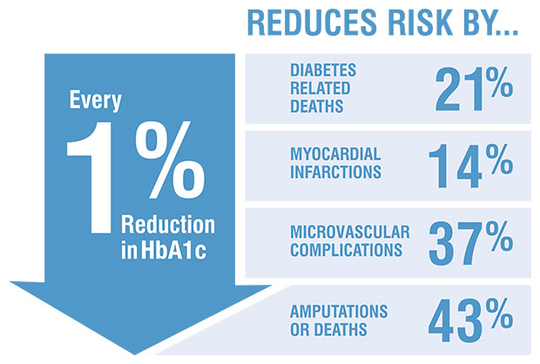
Suggestions for Improving this Measure (PDSA)
Community Education, Action, Outreach and Screening Program
PLAN:
Incorporate diabetes management education in secondary school education.
Require HbA1c screening with final high school vaccinations
Community screenings, education, action and outreach programs
DO:
Pass state and/or federal legislature, IRB approval, if necessary
Partner with pharmacies to offer discount or subsidized screenings
Form local community education and action groups
STUDY:
Population and public health studies
Program effectiveness evaluations
Program/cost benefit analysis
ACT:
Process improvement evaluated from studies
Notes:
PLAN:
Since diabetes is so prevalent among Americans, we recommend incorporating diabetes management education into health class curriculum at an early age. This will encourage healthy habits that will help if the student, or one of their family members, is ever diagnosed with diabetes.
Requiring high school students to get an initial HbA1c screen can help set healthy habits and give a baseline on how to improve or maintain a healthy lifestyle.
Community education, action and outreach programs
DO:
Of course for this to be implement, it would have to pass state and/or federal legislature.
It would be interesting if a government body agreed to subsidize HbA1c testing for diabetes management and prevention testing with community education, action and outreach programs. Studies could be conducted to see if the programs save Medicare and Medicaid money for diabetes treatment.
STUDY:
As a stipulation for participating in government subsidized screening, deidentified test results, and possibly demographics could be conducted to continually improve the programs, and see if it’s effective.
It would be interesting if a government body agreed to subsidize HbA1c testing for diabetes management and prevention testing with community education, action and outreach programs. Studies could be conducted to see if the programs save Medicare and Medicaid money for diabetes treatment.
ACT: As the results of the survey are analyzed, it can show what is most and least effective. Then root cause analysis can help improve the program

Slide 9
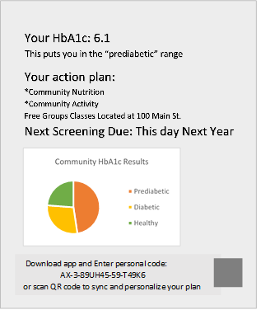
Community Education, Action, Outreach and Screening Program (Continued)
More Details:
Simple, personalized result print-outs, also available in phone app
Graph value vs. normal range
Flags personal risk factors
Says when to be screened next
Informs if is any further action needed:
Suggestions for community resources
Walking groups (with prizes)
Nutritional and cooking classes
Group support classes
Affordable psychiatric resources
Smoking cession programs
Measure Success:
Analyze data collected with screenings (including HbA1c for populations)
Participation in Programs
Surveys from program participants
Notes:
As part of improving this measure, we think that personalized screening results with simple to read results and suggestions for improvement can help people have the power to take control of their health.
Successful implementation of the community education, action, outreach and screening program would be measured by analyzing data collected with screenings.
Another way to measure success could be participation and surveys from people who participate in the programs
Flags include:
First-degree relative with diabetes
High risk race/ethnicity (African American, Latino, Native American, Asian American, or Pacific Islander)
History of Cardiovascular Disease (CVD)
Hypertension
Low HDL Cholesterol or high LDL Cholesterol
Physical inactivity
Women with polycystic ovarian syndrome
Over 45 years of age
It has been more than the recommended time since you last HbA1c test
Every year for prediabetics
Every 3 years for women that have had gestational diabetes
Every 3 years for individuals over 45 years of age

Slide 10
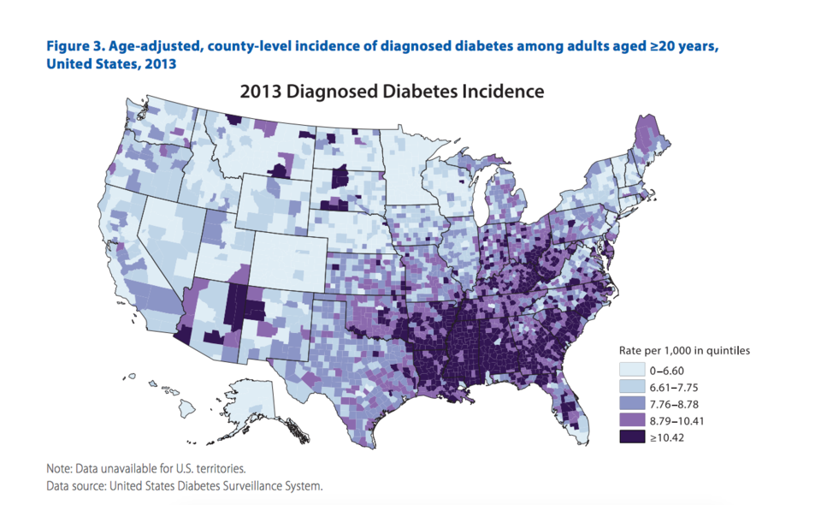
Obtaining and Displaying Data
Data would be collected:
Participants of screenings
Community programs
Clinics
Hospitals
Data would be submitted to the Diabetes Collaborative Registry
Data reports are sent to individual practices
Researchers could request the data for large scale analysis.
Health departments could request that the data be sent to them as well.
The reports include statistics, summaries, charts and graphs.
Health Departments will display report around the community:
Health Clinics
Pharmacies
Community bulletins

Slide 11
Cross the Continuum of Care
Measure could be an Emeasure:
Needs interoperability for device/application to share with care providers.
Could use basic LOINC for shared terminology
Enable patients by providing individualized health plan in app
The length of time between screenings depends on your result
Track management goals
Interoperability Challenges:
Sharing patient data between patient, community and clinicians
HIPPA policies could make gathering information difficult
Patient reliability and accuracy of managing self-health data

Slide 12

System Modeling
Lifestyle Management
Source of Guideline: ADA Standards of Medical Care in Diabetes - 2017
Diabetes Management is difficult when you don’t know what to do:
Education and Support:
Smoking Cessation
Nutrition Therapy
Physical Activity
Psychological Issues

Slide 13
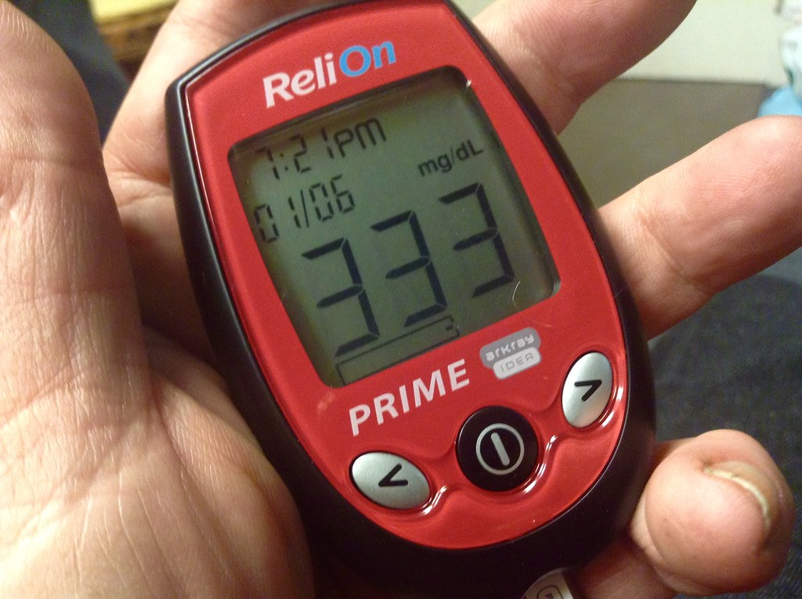
Education and Support
Diabetes Management is difficult when you don’t know what to do
Needs for education and support should be evaluated when:
Diagnosed with diabetes
Annually
New complicating factors that influence management
Health conditions
Physical limitations
Emotional factors
Basic living needs
Transitions in care occur

Slide 14

Smoking Cessation
Advise all patients not to use tobacco products
Quit smoking
This includes e-cigarettes
Smoking cessation counseling
Other forms of treatment

Slide 15

Nutrition Therapy
Diet is the hardest part for many
No one-size-fits all eating pattern
Recommended individualized MNT
Goals:
Emphasize nutrient-dense foods in appropriate portion sizes
Address personal and cultural preferences and
Teach health literacy
Give knowledge of practical tools rather than focusing on certain nutrients
Body weight management:
Modest weight loss
5% of body weight.
Deficit of 500-700 calories per day
Notes:
Carbs:
Lower glycemic index
Reduce refined carbs and sugars
Protein:
1-1.5 g/kg body weight.
Recommended increased protein intake for helping satiety.
If kidney disease is present, lower protein intake to 0.8 g/kg bodyweight per day.
Higher protein has been shown to increase insulin response.
Fat:
Recommended 20-35% of total calories.
Avoid trans-fats,
Mediterranean diets high in Moufas seem to help, but supplements do not.
Sodium:
< 2300 mg/day.
No special supplements, except that metformin causes B12 deficiency.
Other vitamins have not been tested for long-term safety, but I personally recommend AREDS supplements for vision.
Nonnutritive sweeteners are generally recommended to replace sugar but have a lifetime intake limit.

Slide 16

Exercise
Recommendations:
Almost the same as for everyone else
At least 8 week structured exercise program
Children:
60 minutes per day of moderate to vigorous activity aerobic activity
Bone and muscle strengthening activities 3 times per week
Adults:
150 minutes /week of moderate to vigorous activity (over at least 3 days)
2-3 resistance training workouts per week
Decrease prolonged sedentary behavior
Flexibility training for older adults (yoga or tai chi)

Slide 17

Psychosocial Factors
Psychosocial factors have not been shown to have a large effect on HbA1c.
Diabetes distress affects how well a patient follows diabetes management instructions
May impact HbA1c.
A patient’s quality of life will be better if psychosocial problems are addressed.
ADA recommends the PAID assessment of diabetes related emotional distress
Assessments should be done at:
Routine visits
Transitions in care
Changes in complications
etc.
Should be integrated with other care.
Diabetes patients are at risk for:
anxiety
depression
disordered eating
work-life balance issues, and
cognitive decline (in older patients).

Slide 18

System Modeling
We modeled the overall process of getting an HbA1c Screening, including pathways to ensure lifestyle education needs are met.
We used BPMN, CMMN and DMN to model this complex procedure.
We are recommending SNOMED, LOINC, and RxNorm for data model and binding

Slide 19
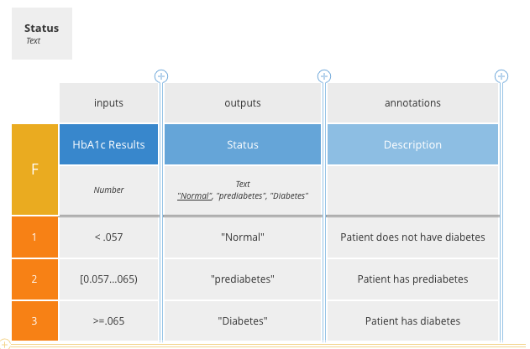
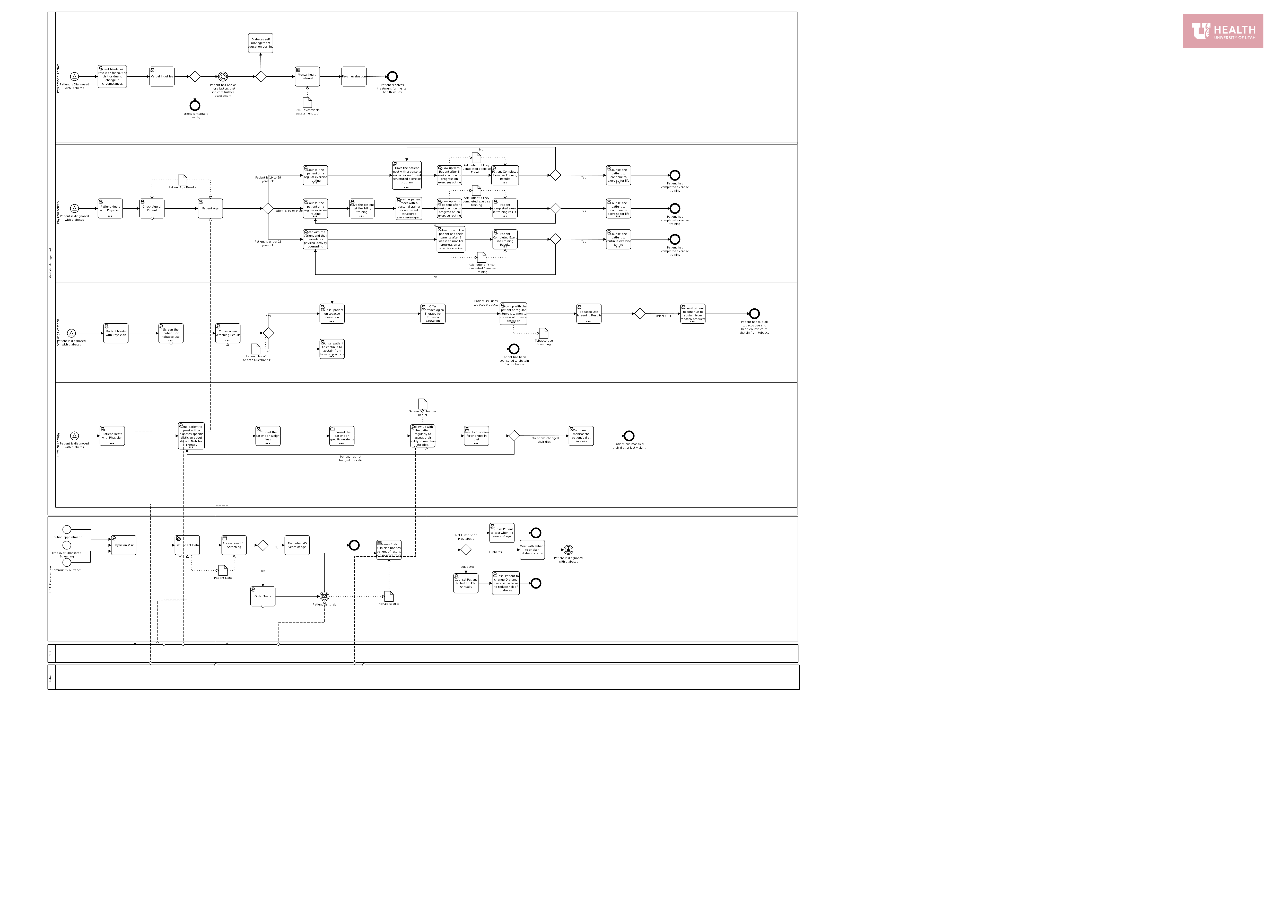
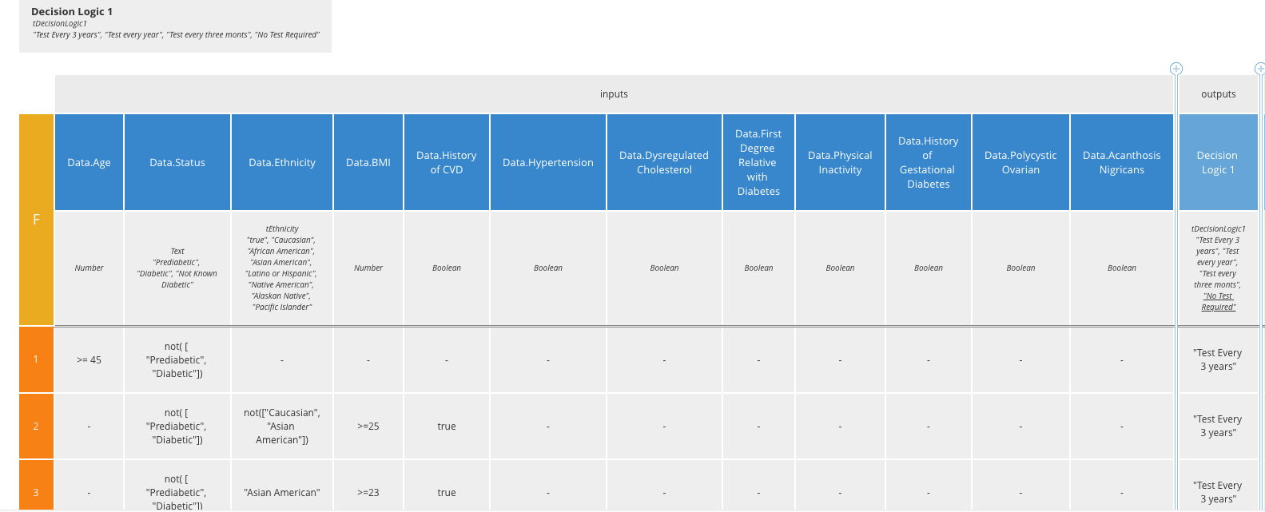
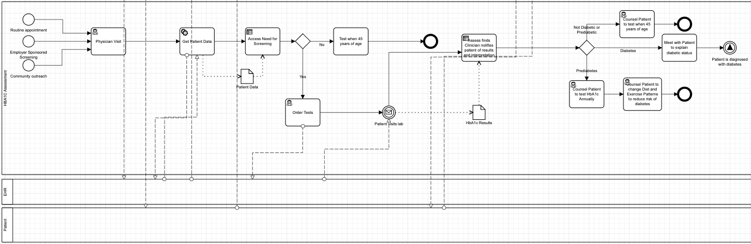
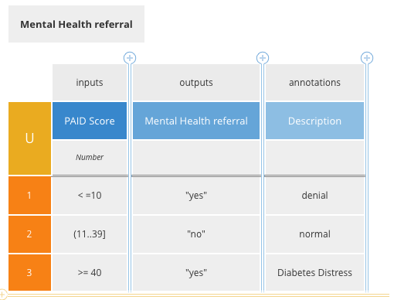
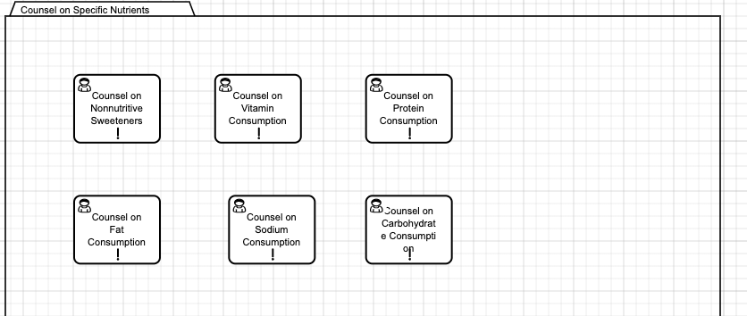
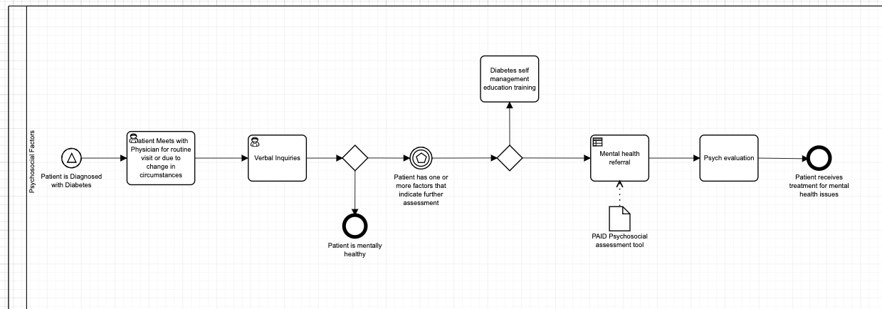
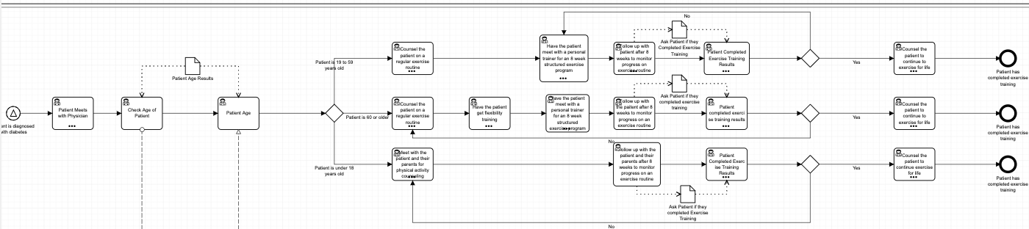
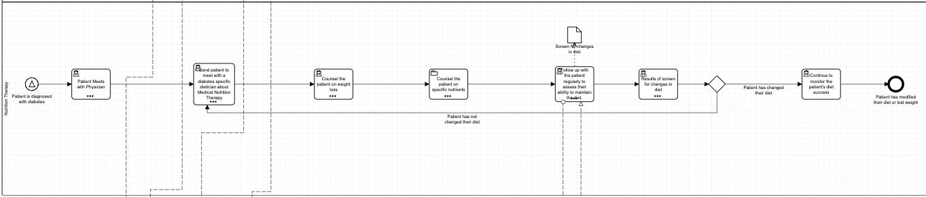
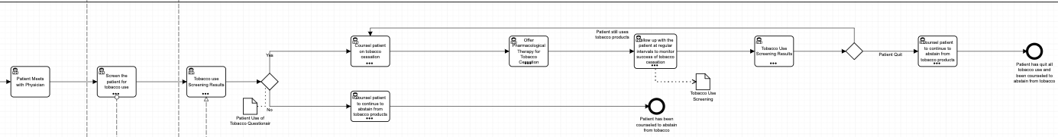
System Modeling

Slide 20

Course Quality Improvement
How would you improve the course?
Add clear expectations and checkpoints.
What would you keep?
In-class walkthroughs of Trisotech
What would you let go?
It would be nice to do away with the online lectures
What would you change?
It would be helpful to have a couple of TAs that know Trisotech
What have you learned from this course?
Aside from learning how to work with Trisotech and the difference process improvement models, our one takeaway is:
Process improvement is continual; once a process is implemented, it should be reevaluated as soon as data points are available

Slide 21
System Modeling

